Slide 1
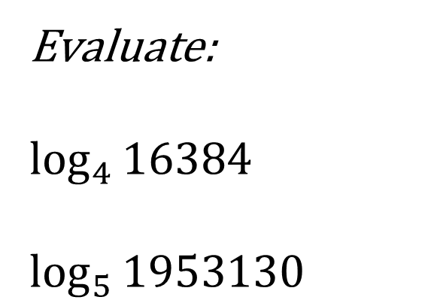
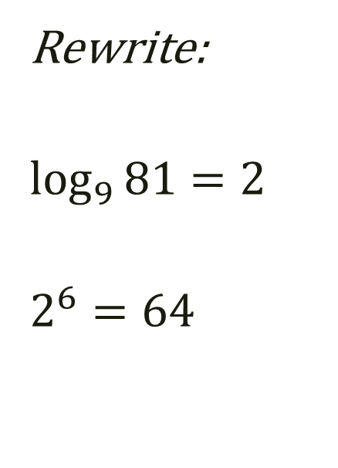
Bell Work
Rewrite:
$$\log_{9}{81}=2$$
$$2^{6}=64$$
Evaluate:
$$\log_{4}{16384}$$
$$\log_{5}{1953130}$$

Slide 2
Algebra 4
Day 74

Slide 3
For Last Time…
Page 457 # 1–9, 13–27(odd)
Page 465 # 1–4, 30–33

Slide 4
Review from Last Time

Slide 5
7.3 Logarithmic Functions as Inverses 7.4 Properties of Logarithms
Objectives:
To write and evaluate logarithmic expressions
To use the properties of logarithms

Slide 6
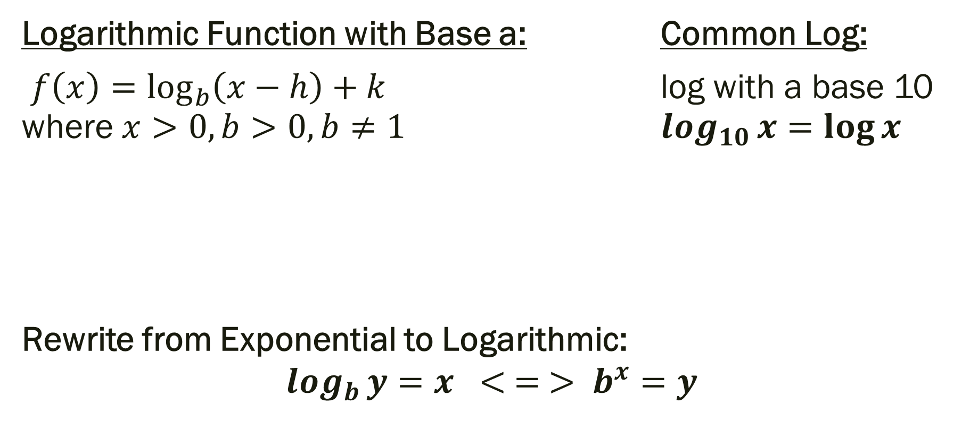
7.3 Logarithmic Functions as Inverses Objective: To write and evaluate logarithmic expressions
Logarithmic Function with Base a: Common Log:
$f\left(x\right)=\log_{b}\left(x−h\right)+k$ log with a base 10 where $x>0, b>0, b≠1$ $\log_{10}{x=\log{x}}$
Rewrite from Exponential to Logarithmic:
$$\log_{b}{y}=x < = > b^{x}=y$$

Slide 7

Rewrite: From log to exponential or exponential log
$$\log_{2}{8}=3$$
$$5^{3}=125$$

Slide 8

Evaluate
$$\log_{7}{49}$$ $$\log_{12}{12}$$
$$\log_{2}{64}$$

Slide 9
7.4 Properties of Logarithms Objective: To use the properties of logarithms

Slide 10

Properties of Logarithms
$\log_{a}{1=0}$ → $a^{0}=1$
$\log_{a}{a=1}$ → $a^{1}=a$
$\log_{a}{a^{x}=x}$ → $a^{\log_{a}{x}}=x$
$$\log_{a}{x=}\log_{a}{y=}>x=y$$

Slide 11
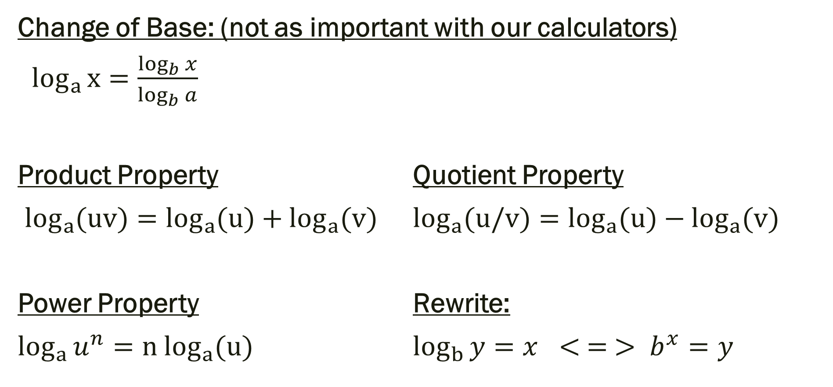
More Properties
Change of Base: (not as important with our calculators)
$\log_{a}{x}=\frac{\log_{b}{x}}{\log_{b}{a}}$
Product Property Quotient Property
$\log_{a}{(uv)}=\log_{a}{(u)}+\log_{a}{(v)}$ $\log_{a}{(u/v)}=\log_{a}{(u)}−\log_{a}{(v)}$
Power Property Rewrite:
$\log_{a}{u^{n}}={n log}_{a}{(u)}$ $\log_{b}{y}=x < = > b^{x}=y$

Slide 12
Examples
Expand: Condense:
$\log_{5}{{25x}^{3}}$ ${5 log}_{6}{x+}{2 log}_{6}{7−3}\log_{6}{w}$
Simplify:
$\log_{4}4$ $\log_{3}81$ $\log_{8}1$ $\log_{w}1$
$9^{\log_{9}{4x}}$ $\log_{7}49^{3x}$ $\log_{t}t^{wx}$ $\log_{25}5$

Slide 13

Quiz
Rewrite (L2) Evaluate (L2)
$${1.) log}_{2}64=6{ 3.) log}_{25}5$$ $2.){ 3}^{4}=81$ $4.) \log{1000}$ Expand (L3) Simplify (L3)
$${ 5.) log}_{4}16x^{5}w^{2} 6.) \log_{w}1−3\log_{w}w$$
Answer the following. (L4)
7.) You deposit $5000 into a savings account with 4.25% interest rate. You can chose to let it exponentially grow normally or continuously for 8 years. Which choice would make you more money? How much more money would it give you?

Slide 14
For Next Time…
Page 457 # 20–30 (even), 46–49
Page 465 # 9–11, 18–20, 30–32

